Slide 1
Software architecture project
Gizem TURAN
1800002414

Slide 2

AGENDA
Database Per Service
Schema of Project Logic
Microservice Structure

Slide 3

Database Per Service
There are 2 services which are inventory and shopping.
Inventory and shopping have their own database.
Commerce provides a communication between inventory and shopping.

Slide 4
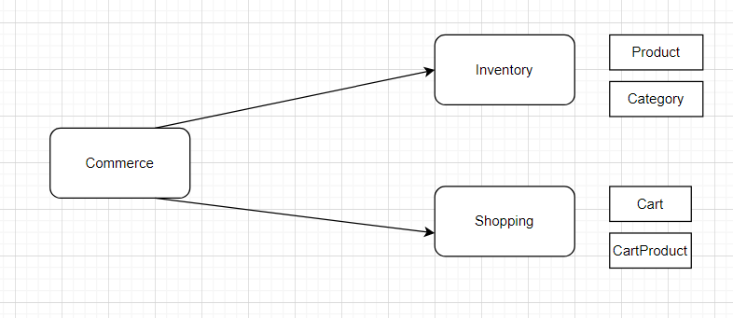
Schema of Project Logic

Slide 5
Microservice Structure
Inventory
Inventory runs on port 8081.
It contains product information.
It aims retrieve and send data about products and categories.
It has controller to take the requests.
Requests respond in service.

Slide 6
Shopping
Shopping runs on port 8082.
It aims retrieve and send data about cart and cartproduct.
It has cart information.
It has controller to take the requests.
Requests respond in service.

Slide 7
Commerce
It communicates other microservices to send information.
It has controller to take the requests.
Requests respond in service.

Slide 8




Thank you

